Slide 1

Chapter 6: Priority Queues, AKA Heaps

Slide 2
Queues with special properties
Consider applications
ordering CPU jobs
searching for the exit in a maze (or looking for moves in the rotation puzzle game)
emergency room admission processing
Goals
short jobs should go first
most promising nodes should be searched first
most urgent cases should go first
Anything greedy
Notes:
Alright, now we all remember what a tree is. Let’s harken back to queues now.
Here are some possible applications of a queue which aren’t quite right.
All of these want to favor certain entries in the Queue. How do we handle that?

Slide 3
Priority Queue ADT
Priority Queue operations
create
destroy
insert
deleteMin
is_empty
Priority Queue property: for two elements in the queue, x and y, if x has a lower priority value than y, x will be deleted before y
F(7) E(5)
D(100) C(4)
B(6)
G(9)
insert
deleteMin
C(4)
Notes:
We need a new ADT for this. One that returns the best (which we’ll generally define as lowest priority value) node next.
I’m often going to represent priority queues as collections of priorities; remember that they are collections of data with priorities. MOREOVER, some priority queues don’t even need priorities, just the ability to compare priorities. (all of the ones we’ll talk about fall in this category).

Slide 4
Naïve Priority Queue Data Structures
Unsorted list:
Sorted list:
BST trees
Splay trees
AVL trees
We maintain total order, but that is more than we need. Can we benefit by keeping less information?
Notes:
OK, let’s look at some ways we might implement priority Qs.
Unsorted lists give us fast inserts, but we have to search the whole list to delete.
Sorted lists give us fast delete (it’s just the first element!), but we have to either search the whole list (for ll) or move the whole list (for array) on an instert.

Slide 5
Binary Heap Priority Queue Data Structure
Heap-order property (Min Tree)
parent’s key is less than children’s keys
result: minimum is always at the top
Structure property
Termed: almost complete tree with leaf nodes packed to the left
result: depth is always O(log n); next open location always known
2
4
5
7
6
10
8
11
9
12
14
20
How do we find the minimum?
Notes:
Alright, there are two problems with binary search trees as pqs.
First, they’re overkill. Why keep everything ordered? We just need to know the least at any given time.
Second, they’re not guaranteed to be balanced, so we have worst case O(n) times.

Slide 6
Clever Storage Trick allows us to easily find parents/kids without pointers
Calculations:
child:
parent:
root:
next free:
0
2
1
2
4
5
3
4
5
6
7
6
10
8
11
9
12
14
20
7
8
9
10
11
0
1
2
3
4
5
6
7
8
9
10
11
12
2
4
5
7
6
10
8
11
9
12
14
20
Notes:
It so happens that we can store a complete tree in an array and still be able to find children and parents easily. We’ll take advantage of this.
Child:
left = 2*node+1
right = 2*node + 2
parent = floor((node-1)/2)
root = 1
nextfree = length + 1

Slide 7
DeleteMin
pqueue.deleteMin()
2
2
20
4
5
4
5
7
6
10
8
7
6
10
8
11
9
12
14
20
11
9
12
14
20
Notes:
OK, to delete, we start by plucking out that value in O(1) time.
Now, we have a hole at the top, and a node that isn’t proper for a complete tree at the bottom.
So, we fix it by putting the value in the hole, and moving the hole until we restore the heap-order property.

Slide 8
Percolate Down
20
4
4
5
20
5
7
6
10
8
7
6
10
8
11
9
12
14
11
9
12
14
4
4
6
5
6
5
7
20
10
8
7
12
10
8
11
9
12
14
11
9
20
14

Slide 9
Insert – put node where the next node goes – to force shape.
pqueue.insert(3)
2
2
4
5
4
5
7
6
10
8
7
6
10
8
11
9
12
14
20
11
9
12
14
20
3
Notes:
Inserting works similarly. We tack a hole on at the end of the tree, and move that hole _up_ until it’s in the right place for the new value.

Slide 10
Percolate Up
2
2
4
5
4
5
7
6
10
8
7
6
3
8
11
9
12
14
20
3
11
9
12
14
20
10
2
4
3
7
6
5
8
11
9
12
14
20
10

Slide 11
Insert (book’s code)
public void insert( E x )
{ if( size == array.length - 1 )
enlargeArray( array.length * 2 + 1 );
// Percolate up
int hole = ++size;
for( array[0]=x; x.compareTo(array[hole /2]) < 0; hole/=2)
array[ hole ] = array[ hole / 2 ];
array[ hole ] = x;
}
Didn’t have to check for reaching array bound

Slide 12
Insert (starting at 0)
public void insert( E x )
{ if( size == array.length - 1 ) enlargeArray( array.length*2+1 );
// Percolate up
int hole = ++size;
int parent = (hole-1)/2;
while(hole!=0 && x.compareTo(array[parent]) < 0){
array[ hole ] = array[ parent];
hole = parent;
parent = (hole-1)/2;
}
array[ hole ] = x;
}

Slide 13
Performance of Binary Heap
 | Binary heap worst case | Binary heap avg case | AVL tree worst case | BST tree avg case
Insert | O(log n) | O(1) 2.6 compares | O(log n) | O(log n)
Delete Min | O(log n) | O(log n) | O(log n) | O(log n)
In practice: binary heaps much simpler to code, lower constant factor overhead
75% of all nodes are at bottom two levels.
If you insert nodes “somewhat” in order, you have a greater chance of a value being inserted at a lower level.

Slide 14
Heap Sort
Input: unordered array A[0..N]
Build a max heap (largest element is A[0])
For i = 0 to N-1: A[N-i] = Delete_Max()
7
50
22
15
4
40
20
10
35
25
50
40
20
25
35
15
10
22
4
7
40
35
20
25
7
15
10
22
4
50
35
25
20
22
7
15
10
4
40
50

Slide 15
Building a heap
You could build a heap, by adding nodes one at a time to an empty heap.
What could you do more efficiently if you had an array that needed to be heapified?
What if you started at the next to the bottom level, and compared every node to its kids? A node may have to move down to a leaf.
What would be the complexity?

Slide 16
Properties of Heap Sort
Worst case time complexity O(n log n)
Build_heap O(n)
n Delete_Max’s for O(n log n)
In-place sort – only constant storage beyond the array is needed ( no recursion)

Slide 17
Merging?
Different scholarship PQs which need to merge after certain deadlines.
This would not be efficient with an AVL tree or a heap (stored as an array). We need a new idea.

Slide 18
Mergeable Priority Queues: Leftist and Skew Heaps
Leftist Heaps: Binary heap-ordered trees with left subtrees always “longer” than right subtrees
Main idea: Recursively work on right path for Merge/Insert/DeleteMin
Right path is always short → has O(log N) nodes
Merge, Insert, DeleteMin all have O(log N) running time (see text)
Skew Heaps: Self-adjusting version of leftist heaps (amortized)
Do not actually keep track of path lengths
Adjust tree by swapping children during each merge
O(log N) amortized time per operation for a sequence of M operations

Slide 19
Leftist Heaps
A heap structure that enables fast merges
Notes:
What if you had networked printers or CPUs and one of them went down.
Now you want to merge the priority queues!
How can we do that?
Here’s two naïve ways.
1st attempt: If the two trees are the same size: O(n log n)
2nd attempt: O(n) (that’s how long buildHeap takse)

Slide 20
Definition: Null Path Length
the null path length (npl) of a node is the smallest number of nodes between it and a null in the tree
npl(null) = -1
npl(leaf) = 0
npl(single-child node) = 0
2
3
1
7
4
1
0
9
13
1
6
0
8
0
another way of looking at it:
npl is the height of complete subtree rooted at this node
0
0
15
19
9
0

Slide 21
Leftist Heap Properties
Heap-order property
parent’s priority value is ≤ childrens’ priority values
result: minimum element is at the root
Leftist property
null path length of left subtree is ≥ npl of right subtree
result: tree is at least as “heavy” on the left as the right
Are leftist trees complete? Balanced?
Notes:
So, here are the formal properties of a leftist heap.
Heap-order, of course.
And, the leftist property; this means that the npl of the right child is never greater than that of the left child.
Are leftist trees necessarily complete or balanced? NO. In fact, a _great_ leftist tree is a string of nodes all on the left!

Slide 22
So, is this tree leftist? If not, how can you fix it without destroying heap?
2
3
1
7
4
1
0
9
13
1
6
0
8
0
0
0
0
15
19
9

Slide 23
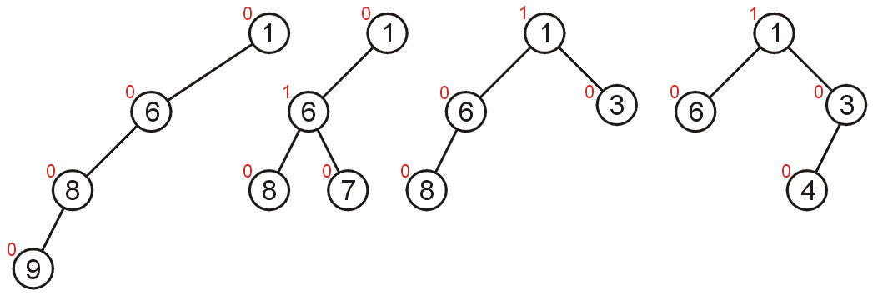
All shapes of leftist trees with 4 nodes

Slide 24
Leftist tree examples
NOT leftist
leftist
leftist
2
2
0
1
1
1
1
0
0
1
0
0
1
0
0
0
1
0
0
0
0
0
0
0
0
0
every subtree of a leftist
tree is leftist!
0
0
Notes:
Here are some training examples to help you learn.
The red nodes break the leftist property for the first tree.
The other two trees are leftist.

Slide 25
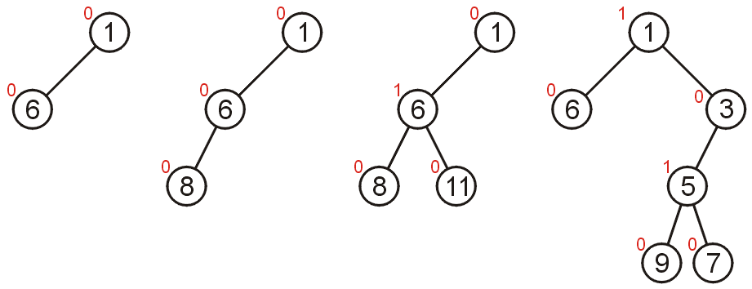
Are these leftist? (not always visually what you expect)

Slide 26
Right Path in a Leftist Tree is Short
2
If the right path has length
at least r, the tree has at
least 2^{r} - 1 nodes
Proof by induction
Basis: r = 1. Tree has at least one node: 2¹ - 1 = 1
Inductive step: assume true for r’ < r. The right subtree has a right path of at least r - 1 nodes, so it has at least 2^{r - 1} - 1 nodes. The left subtree must also have a right path of at least r - 1 (otherwise, there is a null path of r - 3, less than the right subtree). Again, the left has 2^{r - 1} - 1 nodes. All told then, there are at least:
2^{r - 1} - 1 + 2^{r - 1} - 1 + 1 = 2^{r} - 1
Basically, the shortest path must be to the right. So, if you always take the shortest path, it can’t be longer than log n.
1
1
1
0
0
0
0
0
0
Notes:
Why do we have this leftist property?
Because it guarantees that the right path is really short compared to the number of nodes in the tree without being as stodgy as the heap structure property.
Here’s a proof which boils down to the fact that if the left path is r long, the null path length must be at least r (otherwise somewhere along there, there’s a node with a larger right npl than left).
Since the tree is complete at least to depth r, there are at least 2^{r} - 1 nodes in the tree.

Slide 27
Leftist Tree Node
private static class Node<E>
{ Node( E theElement )
{ this( theElement, null, null ); }
Node( E theElement, Node<E> lt, Node<E> rt )
{ element = theElement; left = lt; right = rt; npl = 0; }
E element; // The data in the node
Node<E> left; // Left child
Node<E> right; // Right child
int npl; // null path length
}

Slide 28
Merging strategy: Given two leftist heaps, recursively merge the larger value with the right sub-heap of the root On the way out of the recursion, swap trees to maintain the leftist heap property
private Node<E> merge( Node<E>t1, Node<E> t2) {
Node<E> small;
if (t1==null) return t2;
if (t2==null) return t1;
if (t1.element.compareTo( t2.element ) < 0) {
t1->right = merge(t1->right, t2);
small=t1;}
else {
t2->right = merge(t2->right, t1);
small=t2;}
if (notLeftist(small)) swapkids(small);
setNullPathLength(small);
return small;
}
// How is notLeftist determined? It is a separate routine because a child may be Null (so examining t.left.npl is problematic) Write it.

Slide 29
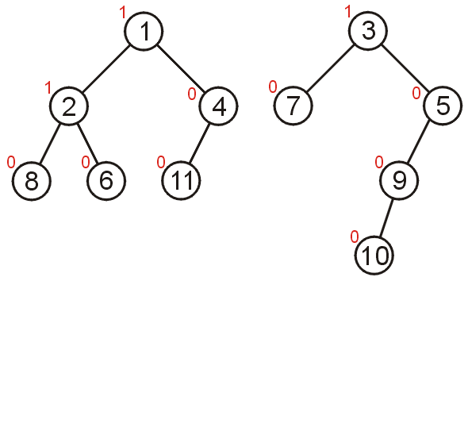
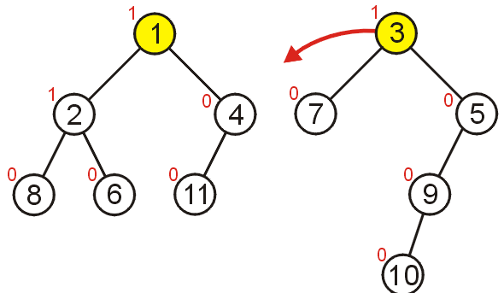
Consider merging these two leftist min heaps

Slide 30
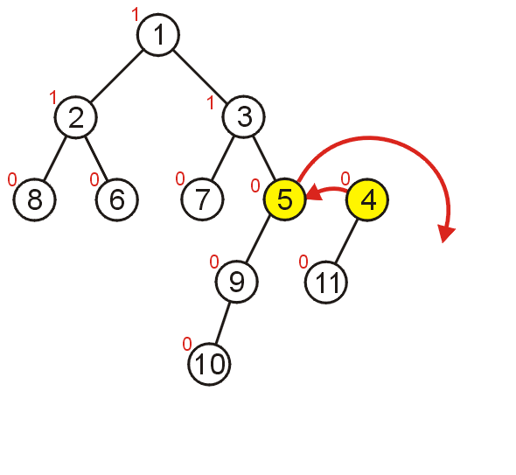
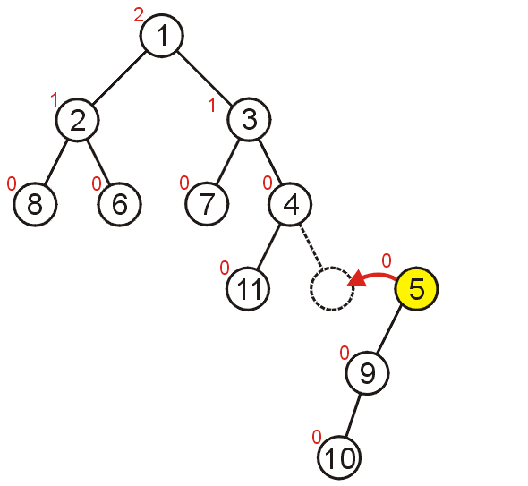
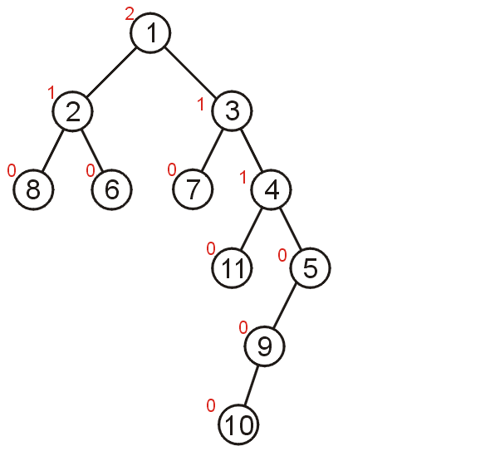

Slide 31
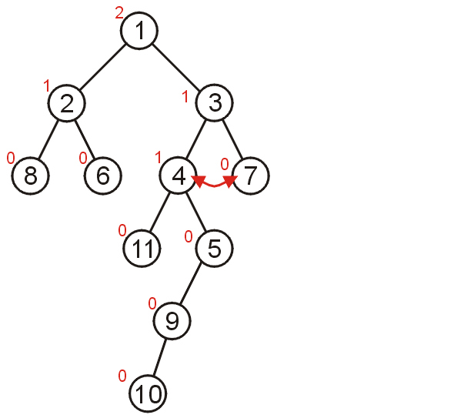
The heaps are merged, but the result is not a leftist heap as 3 is unhappy. On the way back our of the recursion swap sub-heaps where necessary. Find the unhappy nodes – after updating the null path lengths.

Slide 32
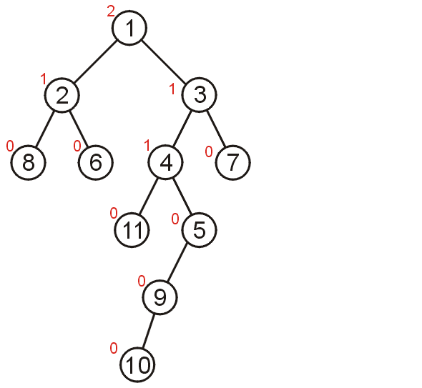
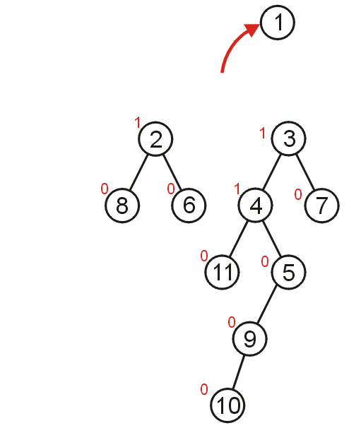
Delete Min

Slide 33
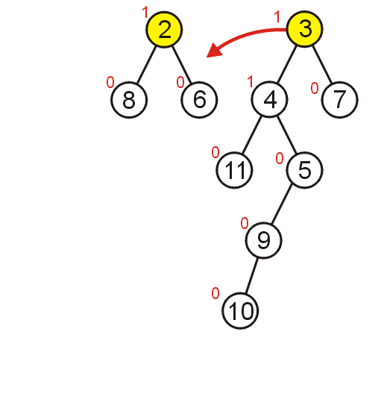
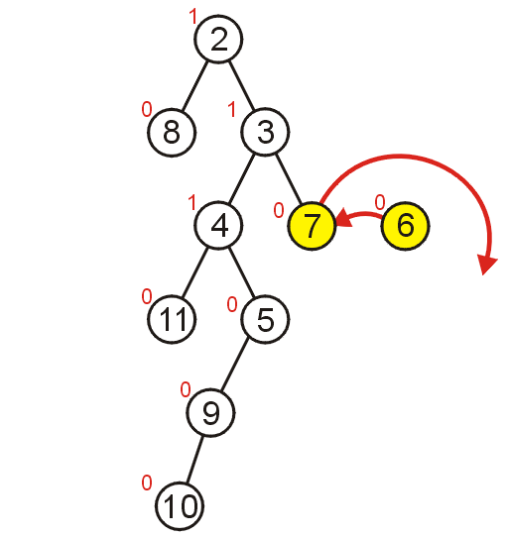
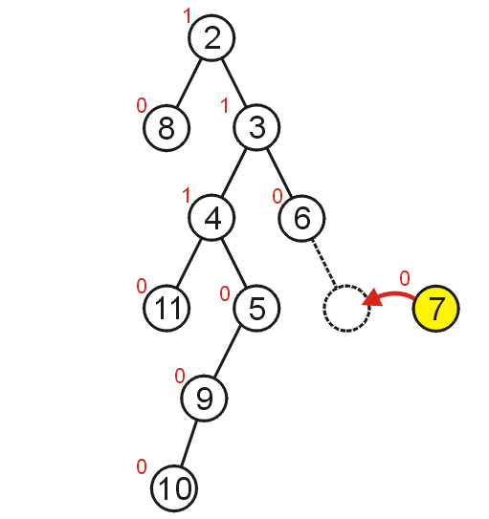
Who is unhappy?

Slide 34
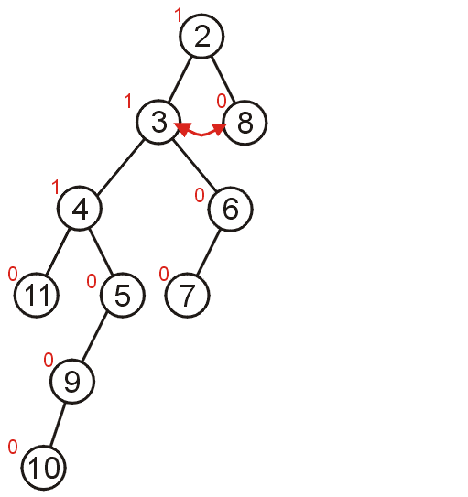
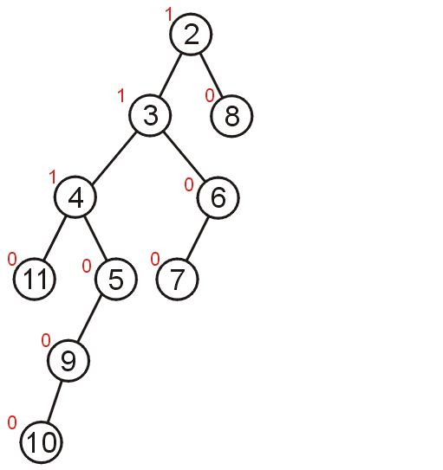
6 has already switched kids Only nodes on access path can be unhappy, right?

Slide 35
Operations on Leftist Heaps Everything is a merge
merge with two trees of total size n: O(log n)
insert with heap size n: O(log n)
pretend node is a size 1 leftist heap
insert by merging original heap with one node heap
deleteMin with heap size n: O(log n)
remove and return root
merge left and right subtrees
merge
merge
Notes:
Now that we have that wicked merge op. Let’s just use it to implement all the other ops.
Is one node a size one leftist heap?

Slide 36
Example
merge
1
?
5
3
0
merge
0
0
7
10
12
1
?
5
5
1
0
3
14
0
0
0
merge
10
12
10
0
0
0
12
7
8
0
0
8
8
0
14
0
8
0
12
Notes:
Alright, let’s try an example.
I’m unwinding the recursion here.
I pulled a fast one merging the last two nodes. I could have reduced that to merging a node with null (which is clearly the original node) but I didn’t for convenience.
Don’t _you_ do that on tests!

Slide 37
Putting together the pieces
?
?
1
3
3
3
0
0
0
7
?
7
1
7
5
1
5
5
0
0
0
0
0
14
0
0
14
0
0
14
10
8
10
8
10
8
0
0
0
12
12
12
Not leftist
Notes:
No, we need to put the example back together, fixing the leftist property as we go.
Are we done here?
NO!
The root’s right child has a higher npl than its left child!

Slide 38
Finally…
1
1
3
3
0
0
7
5
1
5
1
7
0
0
0
0
0
0
14
10
8
10
8
14
0
0
12
12
Notes:
So, we swap the root’s children.
Is the final tree a leftist heap?

Slide 39
Skew Heaps
Problems with leftist heaps
extra storage for npl
Do we need the extra complexity/logic to maintain and check npl
Solution: skew heaps
blind adjusting version of leftist heaps
amortized time for merge, insert, and deleteMin is O(log n)
worst case time for each is O(n)
merge always switches children along right path
Can be done iteratively (as switching can be done on way down)
What do skew heaps remind us of?
Notes:
There are some problems with leftist heaps.
We’ll use skew heaps to fix those problems.
Motivation? Remember that we “often” get heavy right sides when we merge.
So, why not just assume the right side is heavy and move it over automatically?

Slide 40
The Skew Heap – A Simple Modification
We can make a simple modification to the leftist heap and get similar results without storing (or computing) the null path length.
We always merge with the right child, but after merging, we swap the left and right children for every node in the resulting right path of the temporary tree.

Slide 41
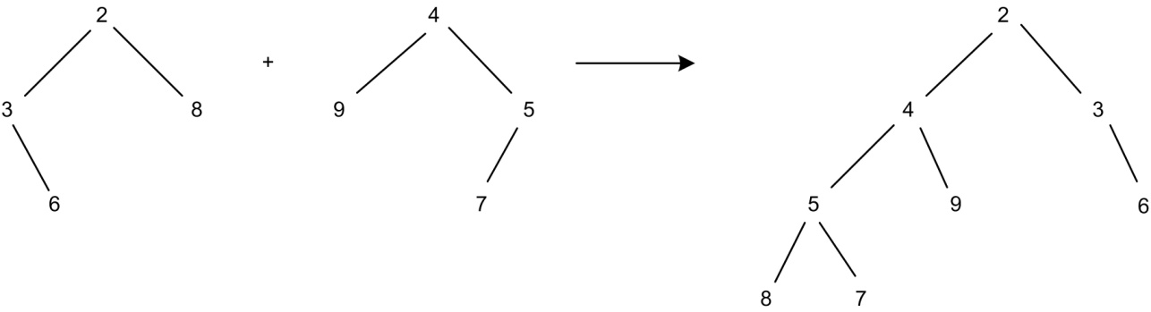
Try this one – do all merging first, then swap kids. You should get the result on the right.

Slide 42
Skew heaps
Two skew heaps
Step 1: Merge the right paths.
5 right heavy nodes

Slide 43
Step 2: Swap the children along the right path.
Alternates adding to each side. Tends to balance

Slide 44
private Node<E> merge( Node<E>t1, Node<E> t2) {
Node<E> small;
if (t1==null) return t2;
if (t2==null) return t1;
if (t1.element.compareTo( t2.element ) < 0) {
t1->right = merge(t1->right, t2);
small=t1;}
else {
t2->right = merge(t2->right, t1);
small=t2;}
swapkids(small);
return small;
}

Slide 45
Notice, only nodes on access path swap kids. Doorbell rings…

Slide 46
But, even though that tree looks good, won’t it just get swapped back after the next merge?
Yes…
However, we don’t tend to get the “ugly” trees in the first place.

Slide 47
Suppose values are added in increasing order
1
1
1
1
1
1
2
2
3
2
3
2
2
3
4
4
1
1
1
1
3
2
3
2
2
3
3
2
5
4
5
4
6
6
4
5
7
5
6
4
Notes:
Animation at http://algoanim.ide.sk/index.php?page=showanim&id=66 may be helpful.

Slide 48
Another idea
Binary heaps were introduced in 1964 by J. Williams.
Algorithms that have been around have received a lot of scrutiny.
People often ask, “Can I do better”?
The next method is not better, but it is quite different.

Slide 49
Binomial Queues
Binomial queues support PQ operations in O(log N) time
Idea: Maintain a collection of heap-ordered trees
Forest of binomial trees
Recursive Definition of Binomial Tree (based on height k):
Only one binomial tree for a given height
Binomial tree of height 0 = single root node
Binomial tree of height k = B_{k} = Attach B_{k-1} to root of another B_{k-1}

Slide 50
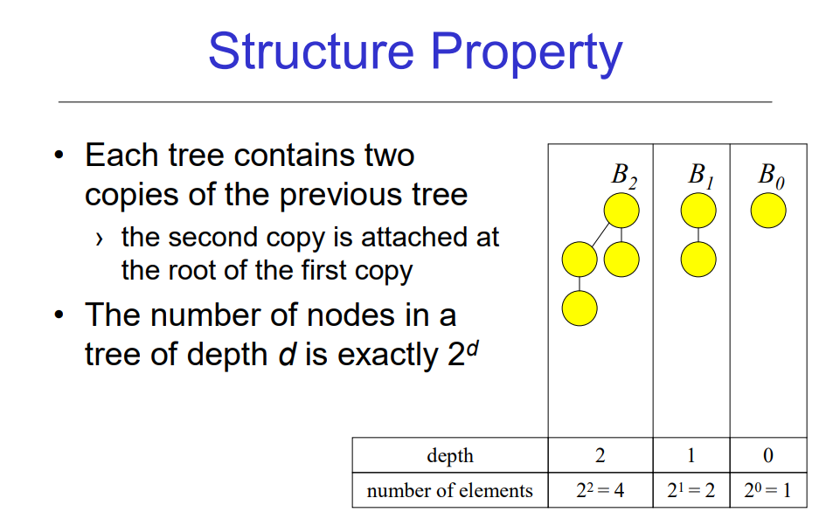

Slide 51
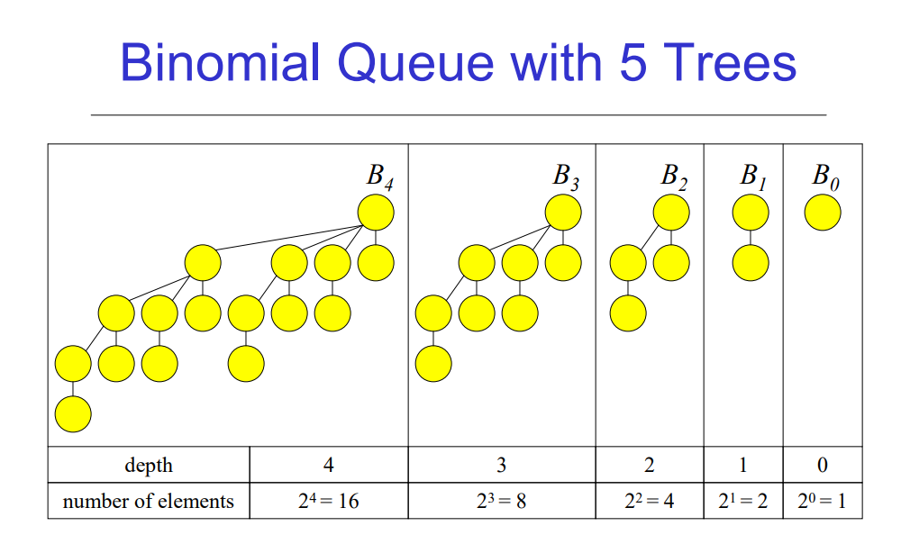

Slide 52
Building a Binomial Tree
To construct a binomial tree B_{k} of height k:
Take the binomial tree B_{k-1} of height k-1
Place another copy of B_{k-1} one level below the first
Attach it to the root of the first tree.
Binomial tree of height k has exactly 2^{k} nodes (by induction)
B₀ B₁ B₂ B₃
5

Slide 53
Building a Binomial Tree
To construct a binomial tree B_{k} of height k:
Take the binomial tree B_{k-1} of height k-1
Place another copy of B_{k-1} one level below the first
Attach the root nodes
Binomial tree of height k has exactly 2^{k} nodes (by induction)
B₀ B₁ B₂ B₃
9
3
5

Slide 54
Building a Binomial Tree
To construct a binomial tree B_{k} of height k:
Take the binomial tree B_{k-1} of height k-1
Place another copy of B_{k-1} one level below the first
Attach the root nodes
Binomial tree of height k has exactly 2^{k} nodes (by induction)
B₀ B₁ B₂ B₃
6
13
3
19
5
7
9

Slide 55
How do a findMin?
Have to search all trees.
How many trees is that?

Slide 56
Building a Binomial Tree
To construct a binomial tree B_{k} of height k:
Take the binomial tree B_{k-1} of height k-1
Place another copy of B_{k-1} one level below the first
Attach the root nodes
Binomial tree of height k has exactly 2^{k} nodes (by induction)
B₀ B₁ B₂ B₃

Slide 57
Why termed Binomial?
Why are these trees called binomial?
Hint: how many nodes at depth d (in one tree)?
B₀ B₁ B₂ B₃

Slide 58
Why Binomial?
Why are these trees called binomial?
Hint: how many nodes at depth d?
Number of nodes at different depths d for B_{k} =
[1], [1 1], [1 2 1], [1 3 3 1], …
Binomial coefficients of (a + b)^{k} = k!/((k-d)!d!)
B₀ B₁ B₂ B₃

Slide 59
Definition of Binomial Queues
Binomial Queue = “forest” of heap-ordered binomial trees. Not all trees need to be present in queue
B₀ B₂ B₀ B₁ B₃
5
21
1
4
3
9
7
12
9
4
6
8
11
5
7
Binomial queue H1
5 elements = 101 base 2
→ B₂ B₀
Binomial queue H2
11 elements = 1011 base 2
→ B₃ B₁ B₀
6

Slide 60
Binomial Queue Properties
Suppose you are given a binomial queue of N nodes
There is a unique set of needed binomial tree sizes for N nodes
What is the maximum number of trees we need? log(N)

Slide 61
Binomial Queues: Merge
Main Idea: Merge two binomial queues by merging individual binomial trees
Since B_{k+1} is just two B_{k}’s attached together, merging trees is easy
Steps for creating new queue by merging:
Start with B_{k} for smallest k in either queue.
If only one B_{k}, add B_{k} to new queue and go to next k.
Merge two B_{k}’s to get new B_{k+1} by making larger root the child of smaller root. Go to step 2 with k = k + 1.

Slide 62
Example: Binomial Queue Merge
H1: H2:
21
1
-1
3
5
7
2
1
3
9
6
8
11
5
7
6

Slide 63
Example: Binomial Queue Merge
H1: H2:
1
-1
3
5
7
2
1
3
21
9
6
8
11
5
7
6

Slide 64
Example: Binomial Queue Merge
H1: H2:
1
-1
5
7
3
2
1
3
9
6
21
8
11
5
7
6

Slide 65
Example: Binomial Queue Merge
H1: H2:
1
-1
7
3
5
2
1
3
21
9
6
8
11
5
7
6

Slide 66
Example: Binomial Queue Merge
H1: H2:
-1
2
1
3
1
8
11
5
7
3
5
6
21
9
6
7

Slide 67
Example: Binomial Queue Merge
H1: H2:
-1
2
1
3
1
8
11
5
7
3
5
6
21
9
6
7

Slide 68
Binomial Queues: Merge and Insert
What is the run time for Merge of two O(N) queues?
How would you insert a new item into the queue?

Slide 69
Binomial Queues: Merge and Insert
What is the run time for Merge of two O(N) queues?
O(number of trees) = O(log N)
How would you insert a new item into the queue?
Create a single node queue B₀ with new item and merge with existing queue
Again, O(log N) time
Example: Insert 1, 2, 3, …,7 into an empty binomial queue

Slide 70
Insert 1,2,…,7
1

Slide 71
Insert 1,2,…,7
1
2

Slide 72
Insert 1,2,…,7
1
3
2

Slide 73
Insert 1,2,…,7
1
3
2
4

Slide 74
Insert 1,2,…,7
1
2
3
4

Slide 75
Insert 1,2,…,7
1
5
2
3
4

Slide 76
Insert 1,2,…,7
1
5
2
3
6
4

Slide 77
Insert 1,2,…,7
1
5
7
2
3
6
4

Slide 78
Binomial Queues: DeleteMin
Steps:
Find tree B_{k} with the smallest root
Remove B_{k} from the queue
Delete root of B_{k} (return this value); You now have a new queue made up of the forest B₀, B₁, …, B_{k-1}
Merge this queue with remainder of the original (from step 2)
Run time analysis: Step 1 is O(log N), step 2 and 3 are O(1), and step 4 is O(log N). Total time = O(log N)
Example: Insert 1, 2, …, 7 into empty queue and DeleteMin

Slide 79
Insert 1,2,…,7
1
5
7
2
3
6
4

Slide 80
DeleteMin Have to look at all roots.
1
5
7
2
3
6
4

Slide 81
DeleteMin Orphan kids (who form a binomial queue)
5
7
2
3
6
4

Slide 82
Merge
5
2
3
6
7
4

Slide 83
Merge Now, can join any two
5
2
3
6
7
4

Slide 84
Merge
5
2
6
7
3
4
DONE!

Slide 85
Implementation of Binomial Queues
Need to be able to scan through all trees, and given two binomial queues find trees that are same size
Use array of pointers to root nodes, B_{k} stored at cell k
Since is only of length log(N), don’t have to worry about cost of copying this array
At each node, keep track of the max subtree rooted at that node
Want to merge by just setting pointers
Need pointer-based implementation of heaps
DeleteMin requires fast access to all subtrees of root

Slide 86
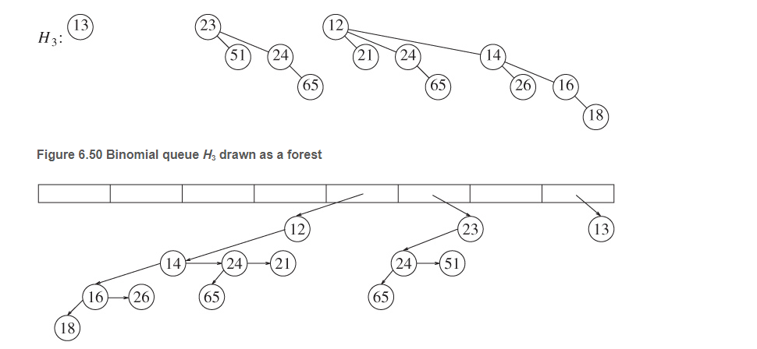

Slide 87
Merge two equal-sized binomial trees
private Node<E> combineTrees( Node<E> t1, Node<E> t2 )
{
if( t1.element.compareTo( t2.element ) > 0 )
return combineTrees( t2, t1 );
t2.nextSibling = t1.leftChild;
t1.leftChild = t2;
return t1;
}

Slide 88
Efficient BuildHeap for Binomial Queues
Brute force Insert one at a time - O(n log n)
Better algorithm:
Start with each element as a singleton tree
Merge trees of size 1
Merge trees of size 2
Merge trees of size 4
Complexity:

Slide 89
Comparing Heaps - at seats pros/cons
AVL tree as PQ
Binary Heaps
Binomial Queues
Leftist Heaps
Skew Heaps
Notes:
Binary: simple, memory efficient, fast, can run buildHeap. cannot merge quickly.
Leftist: supports merge quickly. Supports all other operations asymptotically quickly. Practically, extra storage, link traversals and recursion make it bigger and slower.
Skew: slightly less storage, somewhat faster and simpler than leftist. NOT guaranteed fast on EVERY operation (but guaranteed amortized speed.

